Slide 1
Effects of the solar wind termination shock on cosmic ray modulation in the heliosheath
Ming Zhang, Xi Luo, and Hamid Rassoul
Department of Physics and Space Sciences,
Florida Institute of Technology, Melbourne, Florida, USA
Nikolai Pogolerov
Center for Space Plasma & Aeronomic Research,
University of Alabama in Huntsville, Alabama, USA

Slide 2
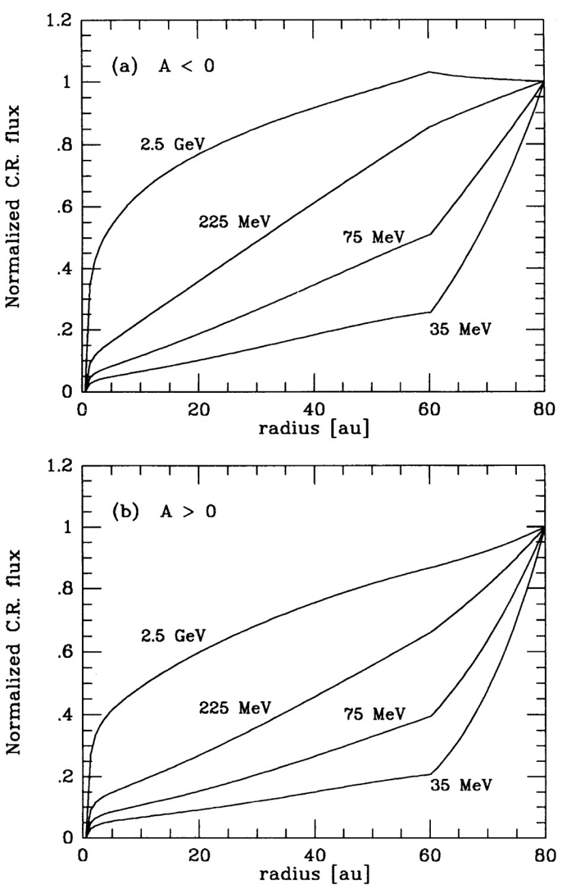
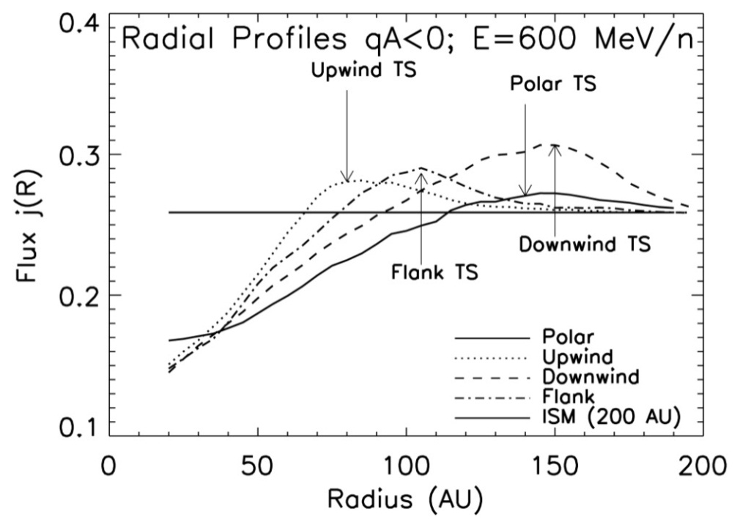
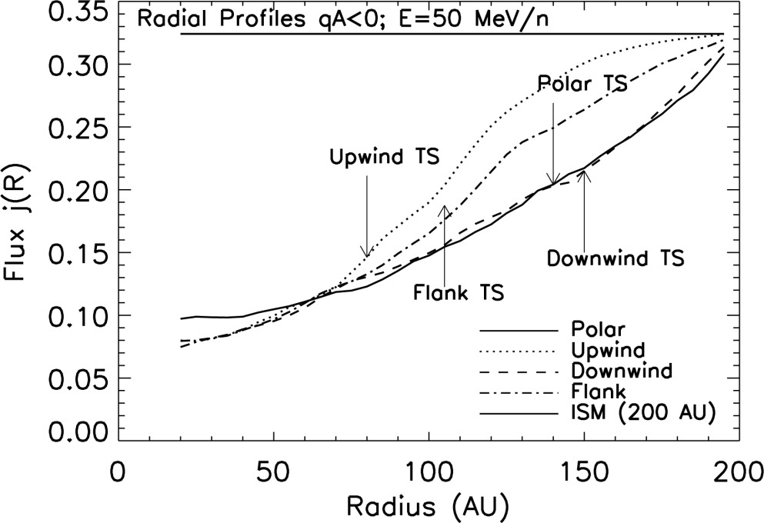
Radial variation of cosmic ray intensity
Jokipii (????) with analytical model of the heliosphere
Ball et al., 2005 with MHD heliosphere model from Linde

Slide 3
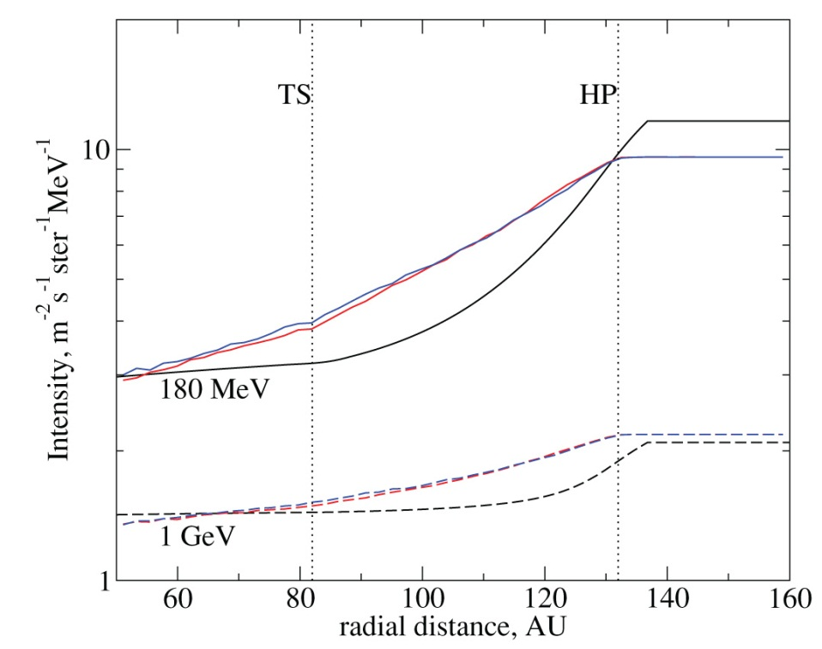
Radial variation of cosmic ray intensity
Florinski and Pogorelov, 2009 with MHD heliosphere model

Slide 4
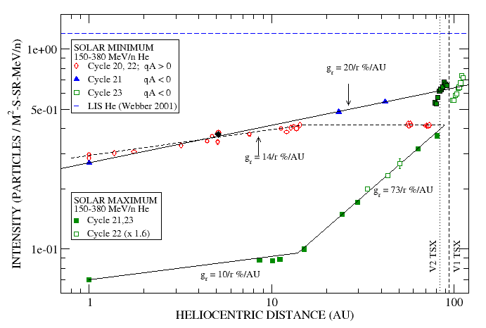
Radial variation of CR flux measured by Voyager
From McDonald, 2010

Slide 5
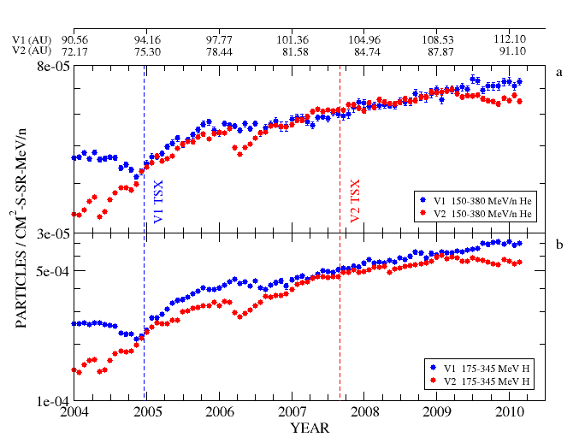
GCR He and H in the Heliosheath
Radial Gradients < 0.2 %/AU over 2005-2009.2
The V2 decrease starting in 2009.2 is not understood

Slide 6
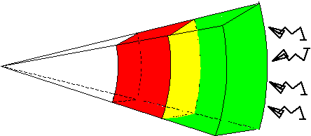
Cosmic ray transport mechanisms in the heliosphere
Drift V_{d}
Solar wind
Convection V_{sw}
ISM
Adiabatic
deceleration
Inward diffusion

Slide 7
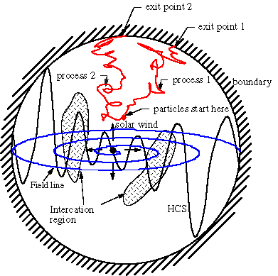
Stochastic method to solve modulation spectra
(p_{e2})
Backward trajectory of particles
Interstellar
Spectrum f_{ism}(p)
(p_{e1})
all starting at (x,p,t)
Modulated spectrum

Slide 8
A spherical (analytical) model of the heliosphere

Slide 9
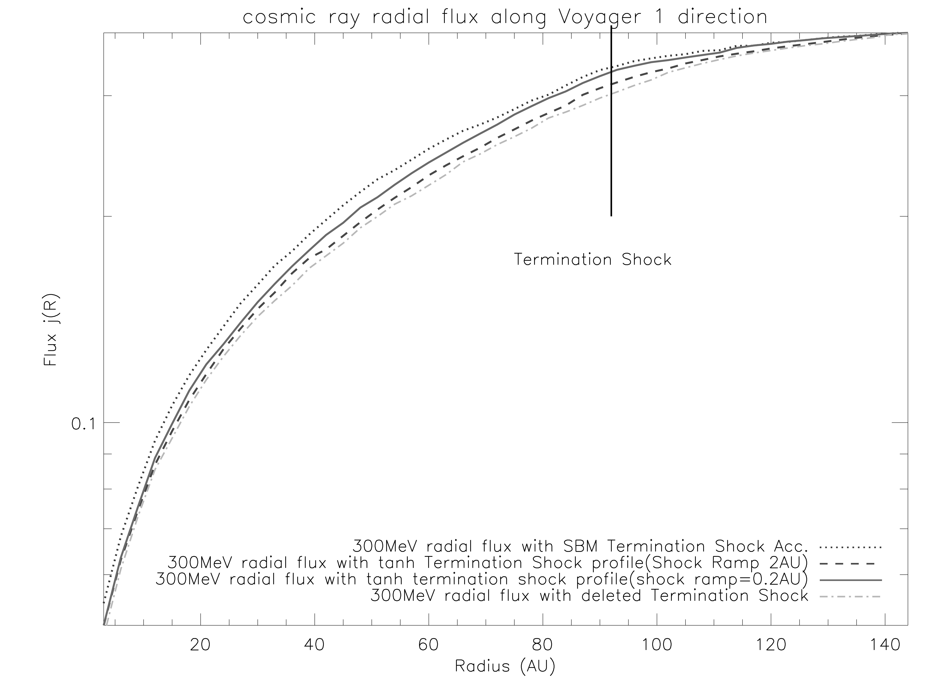

Slide 10
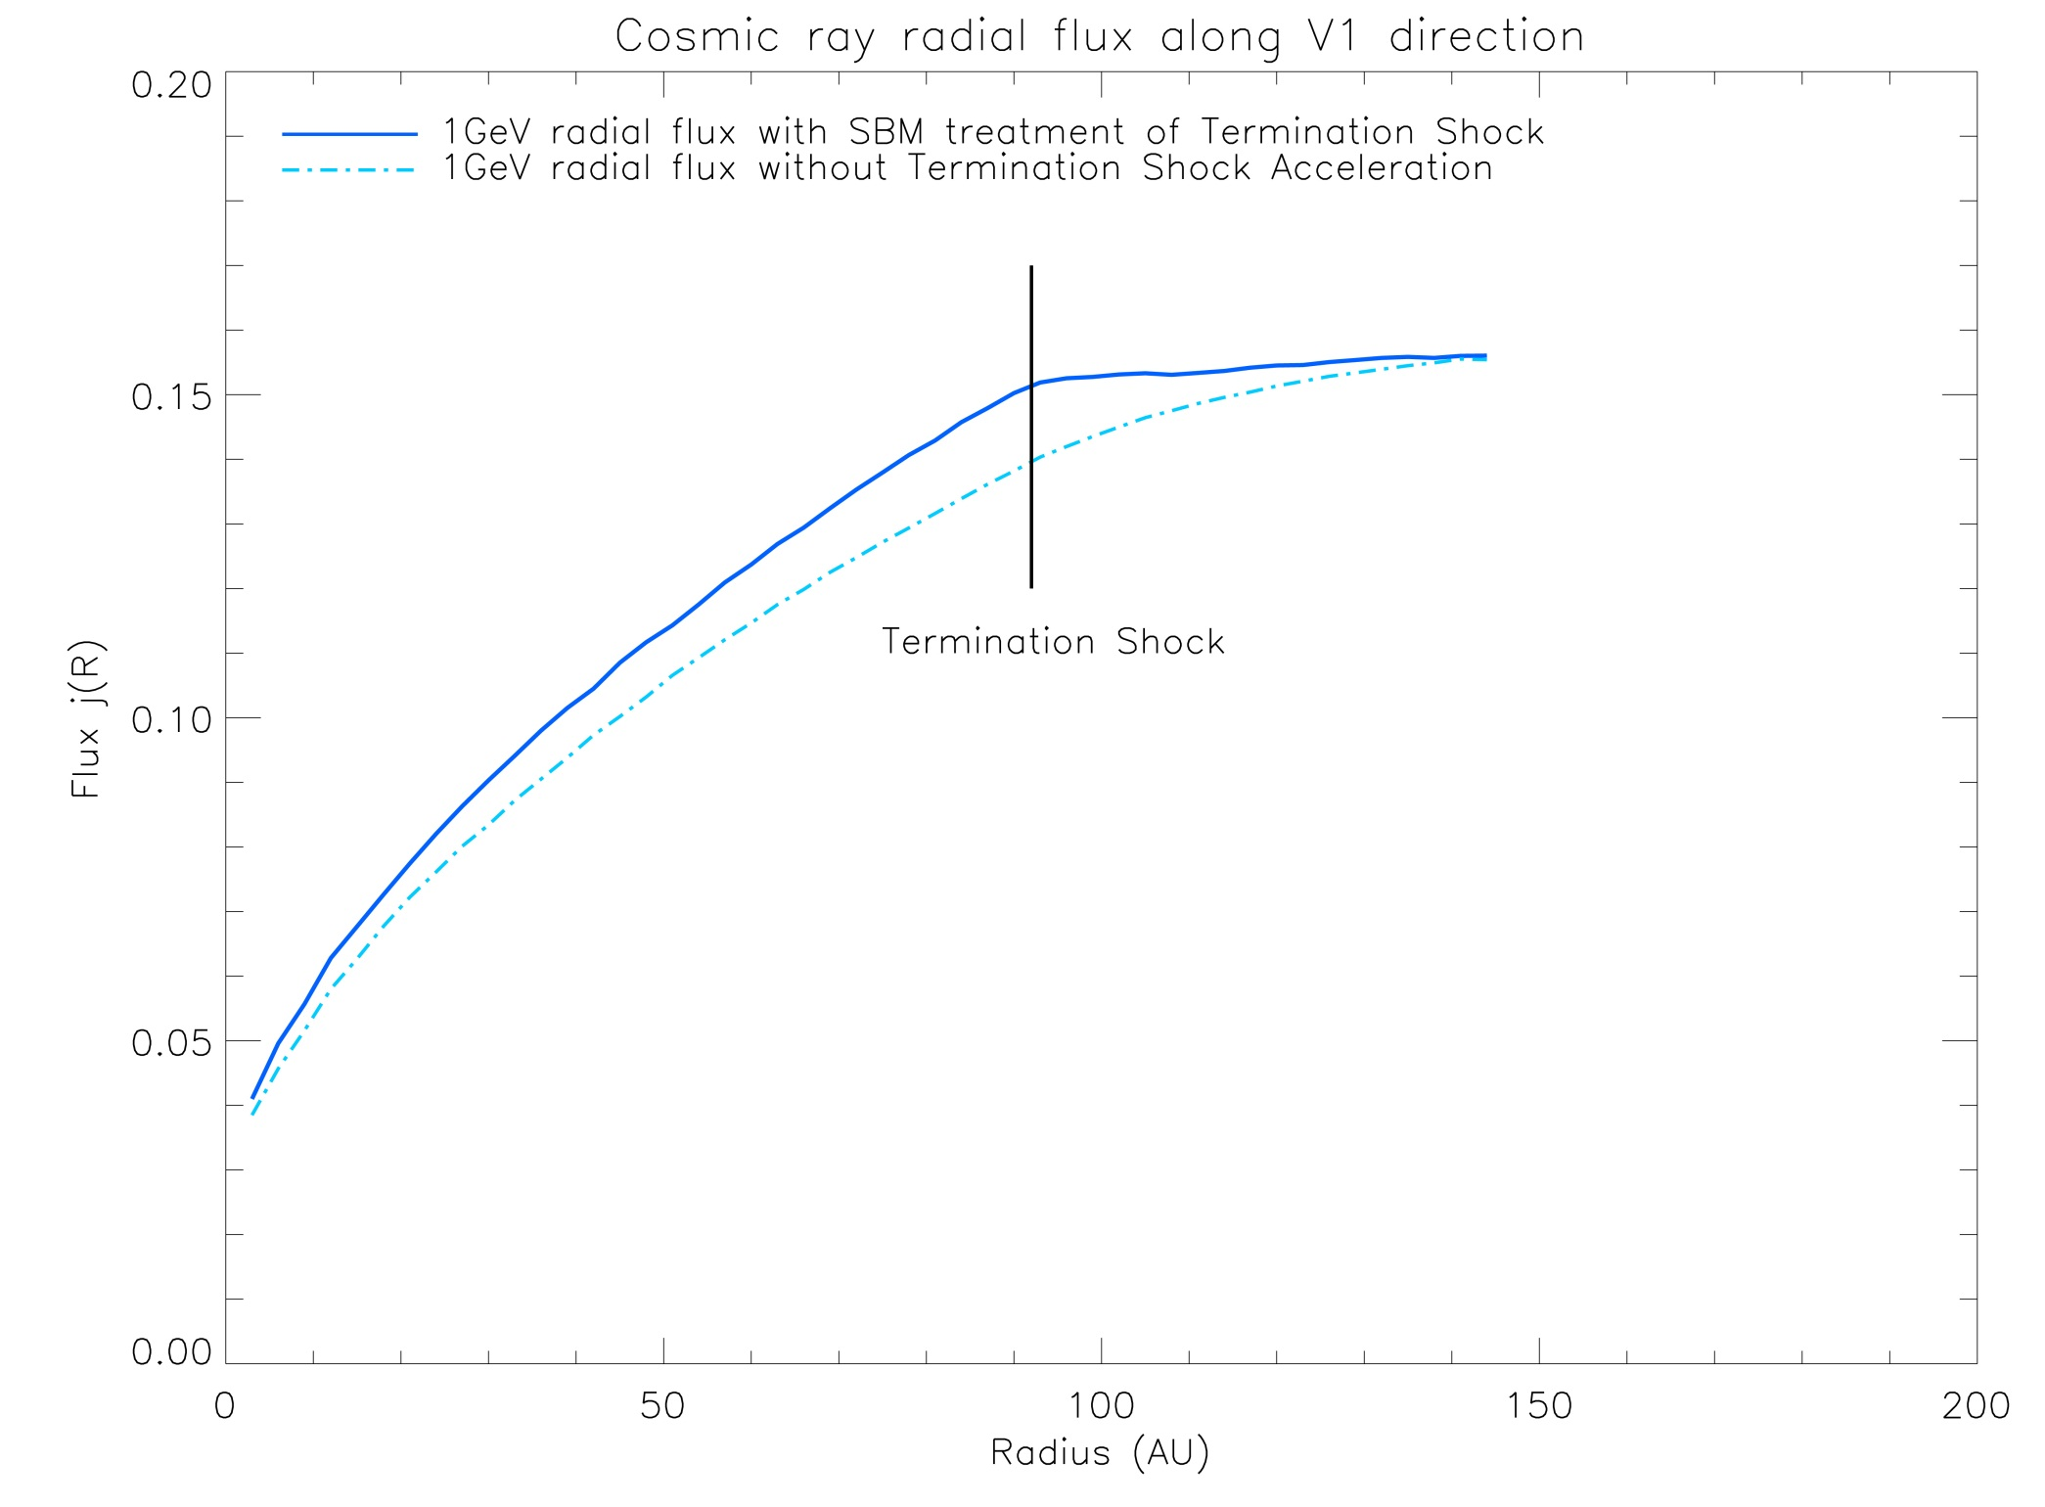

Slide 11
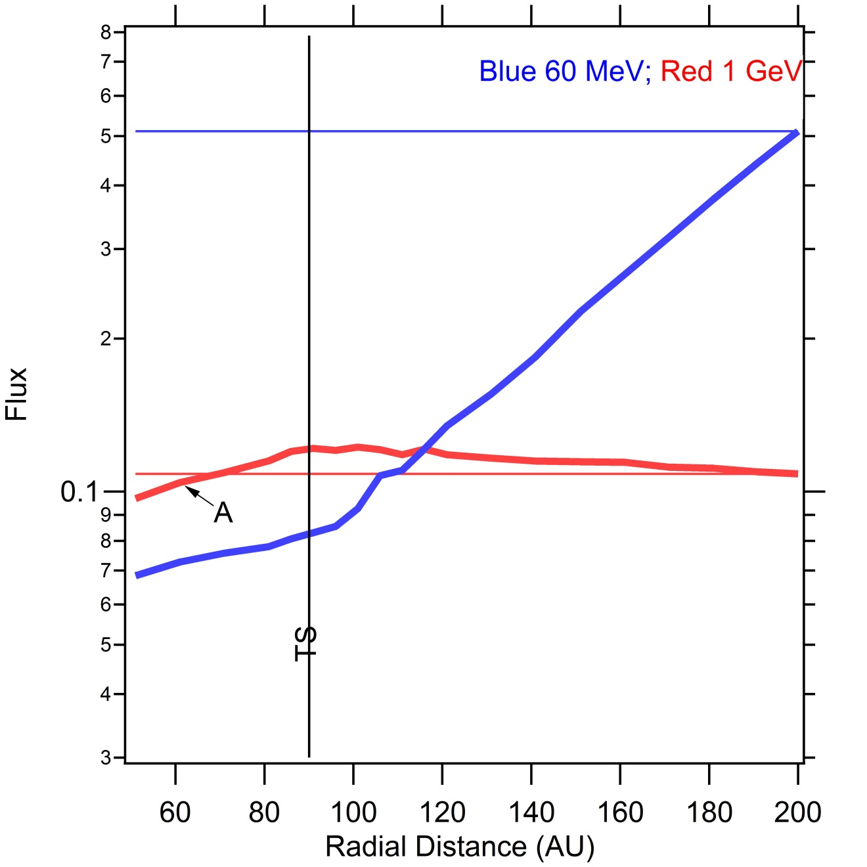
With enhanced perpendicular diffusion

Slide 13
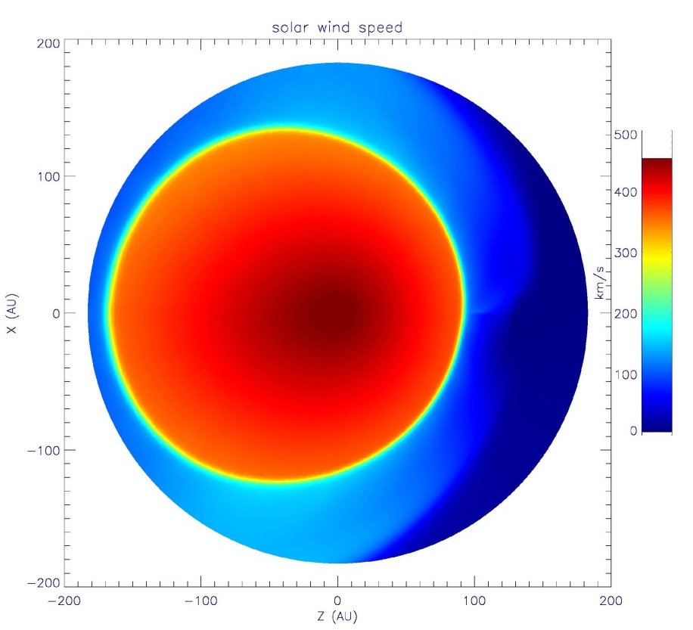
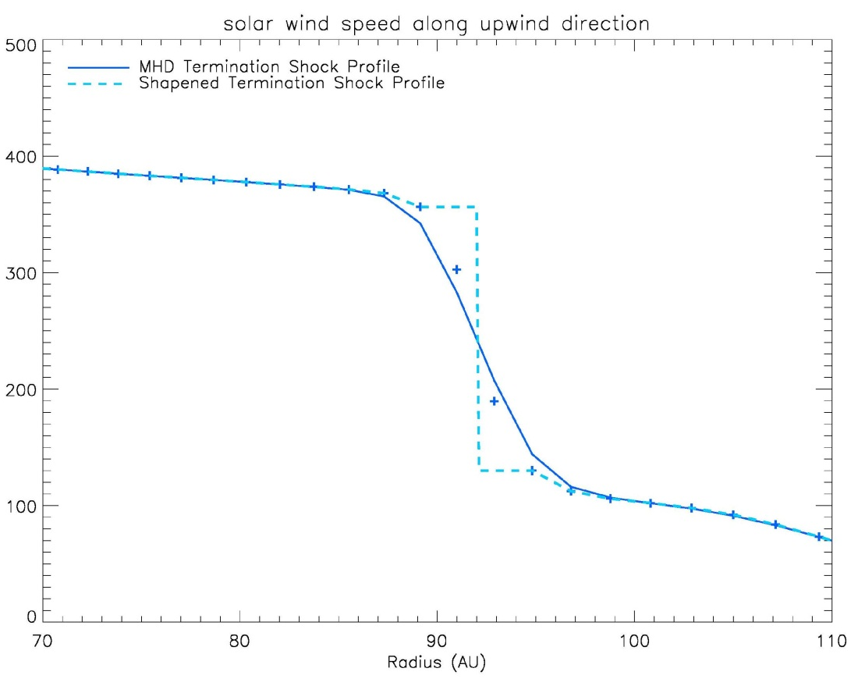
Simulation with MHD heliosphere model
Termination Shock Profile
MHD simulation of the termination shock is several AU width, which is very unrealistic and cause insignificant Diffusive Shock Acceleration.
In our simulation, we dieregard this unrealistic TS from MHD method and Sharpened the Termination Shock.

Slide 14
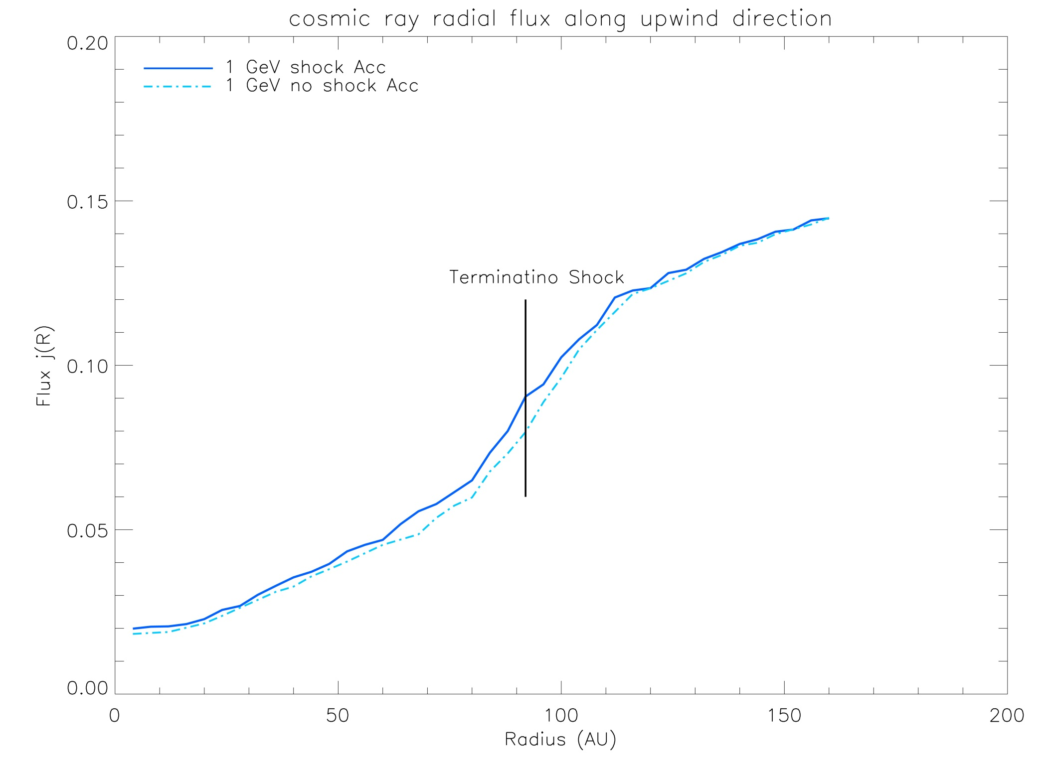
Toward the nose

Slide 15
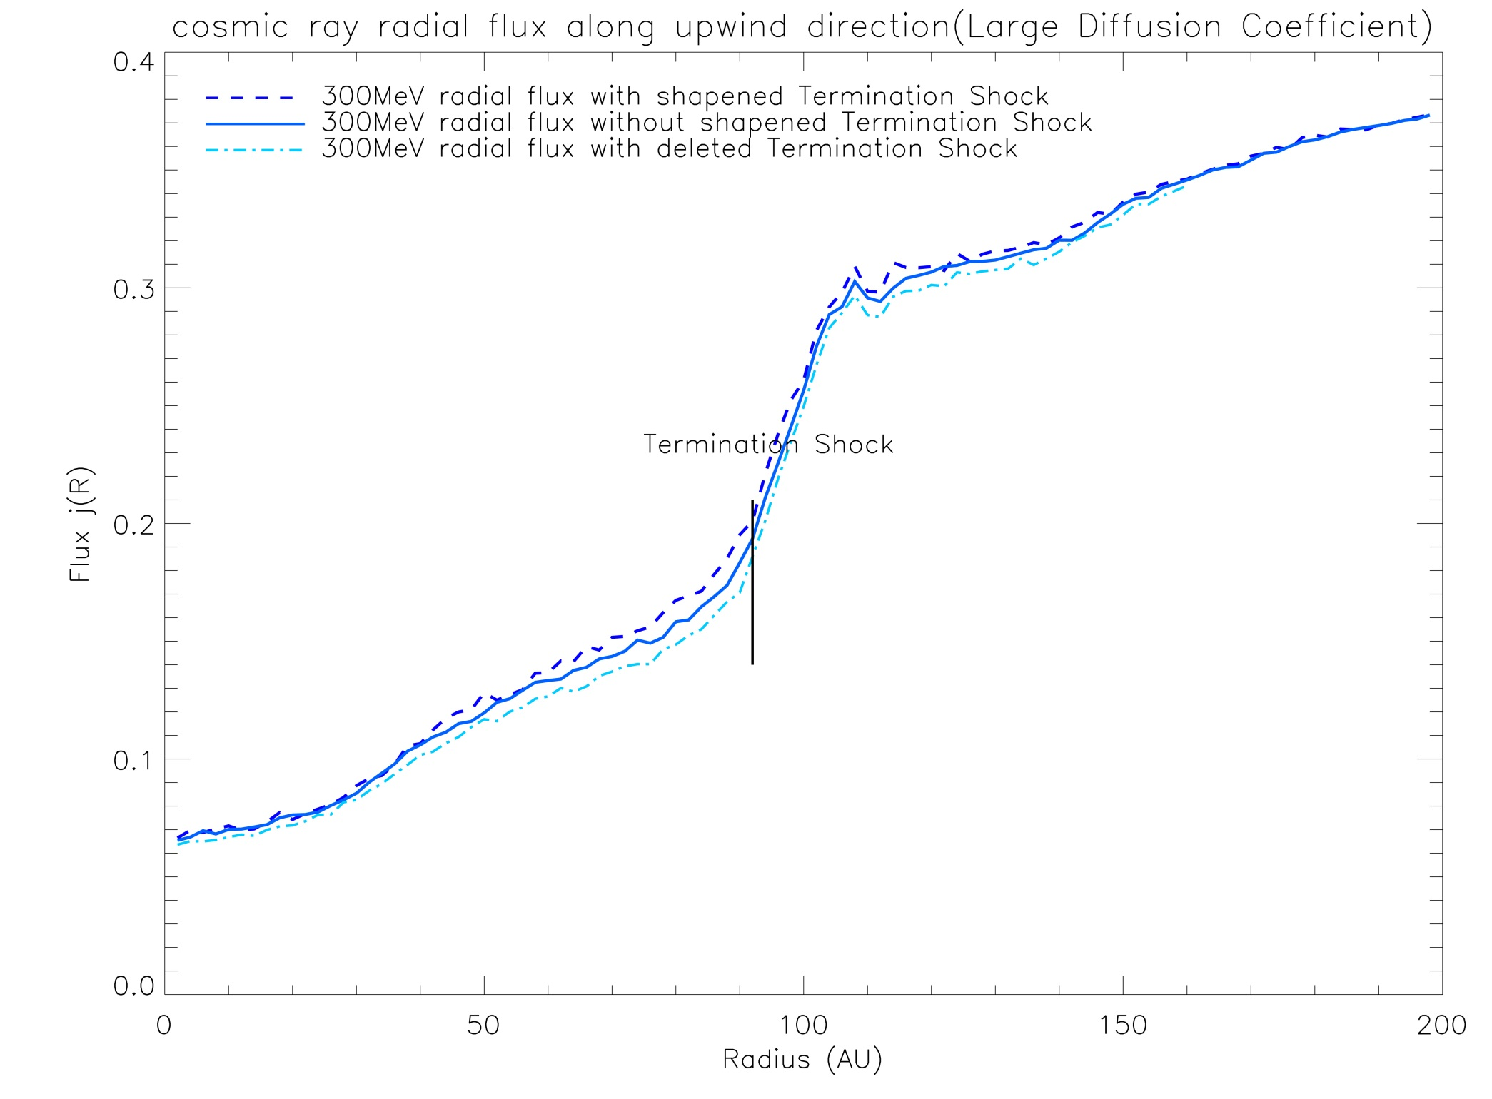

Slide 16
Modulation of Cosmic rays by
Global Merged Interaction Region

Slide 17
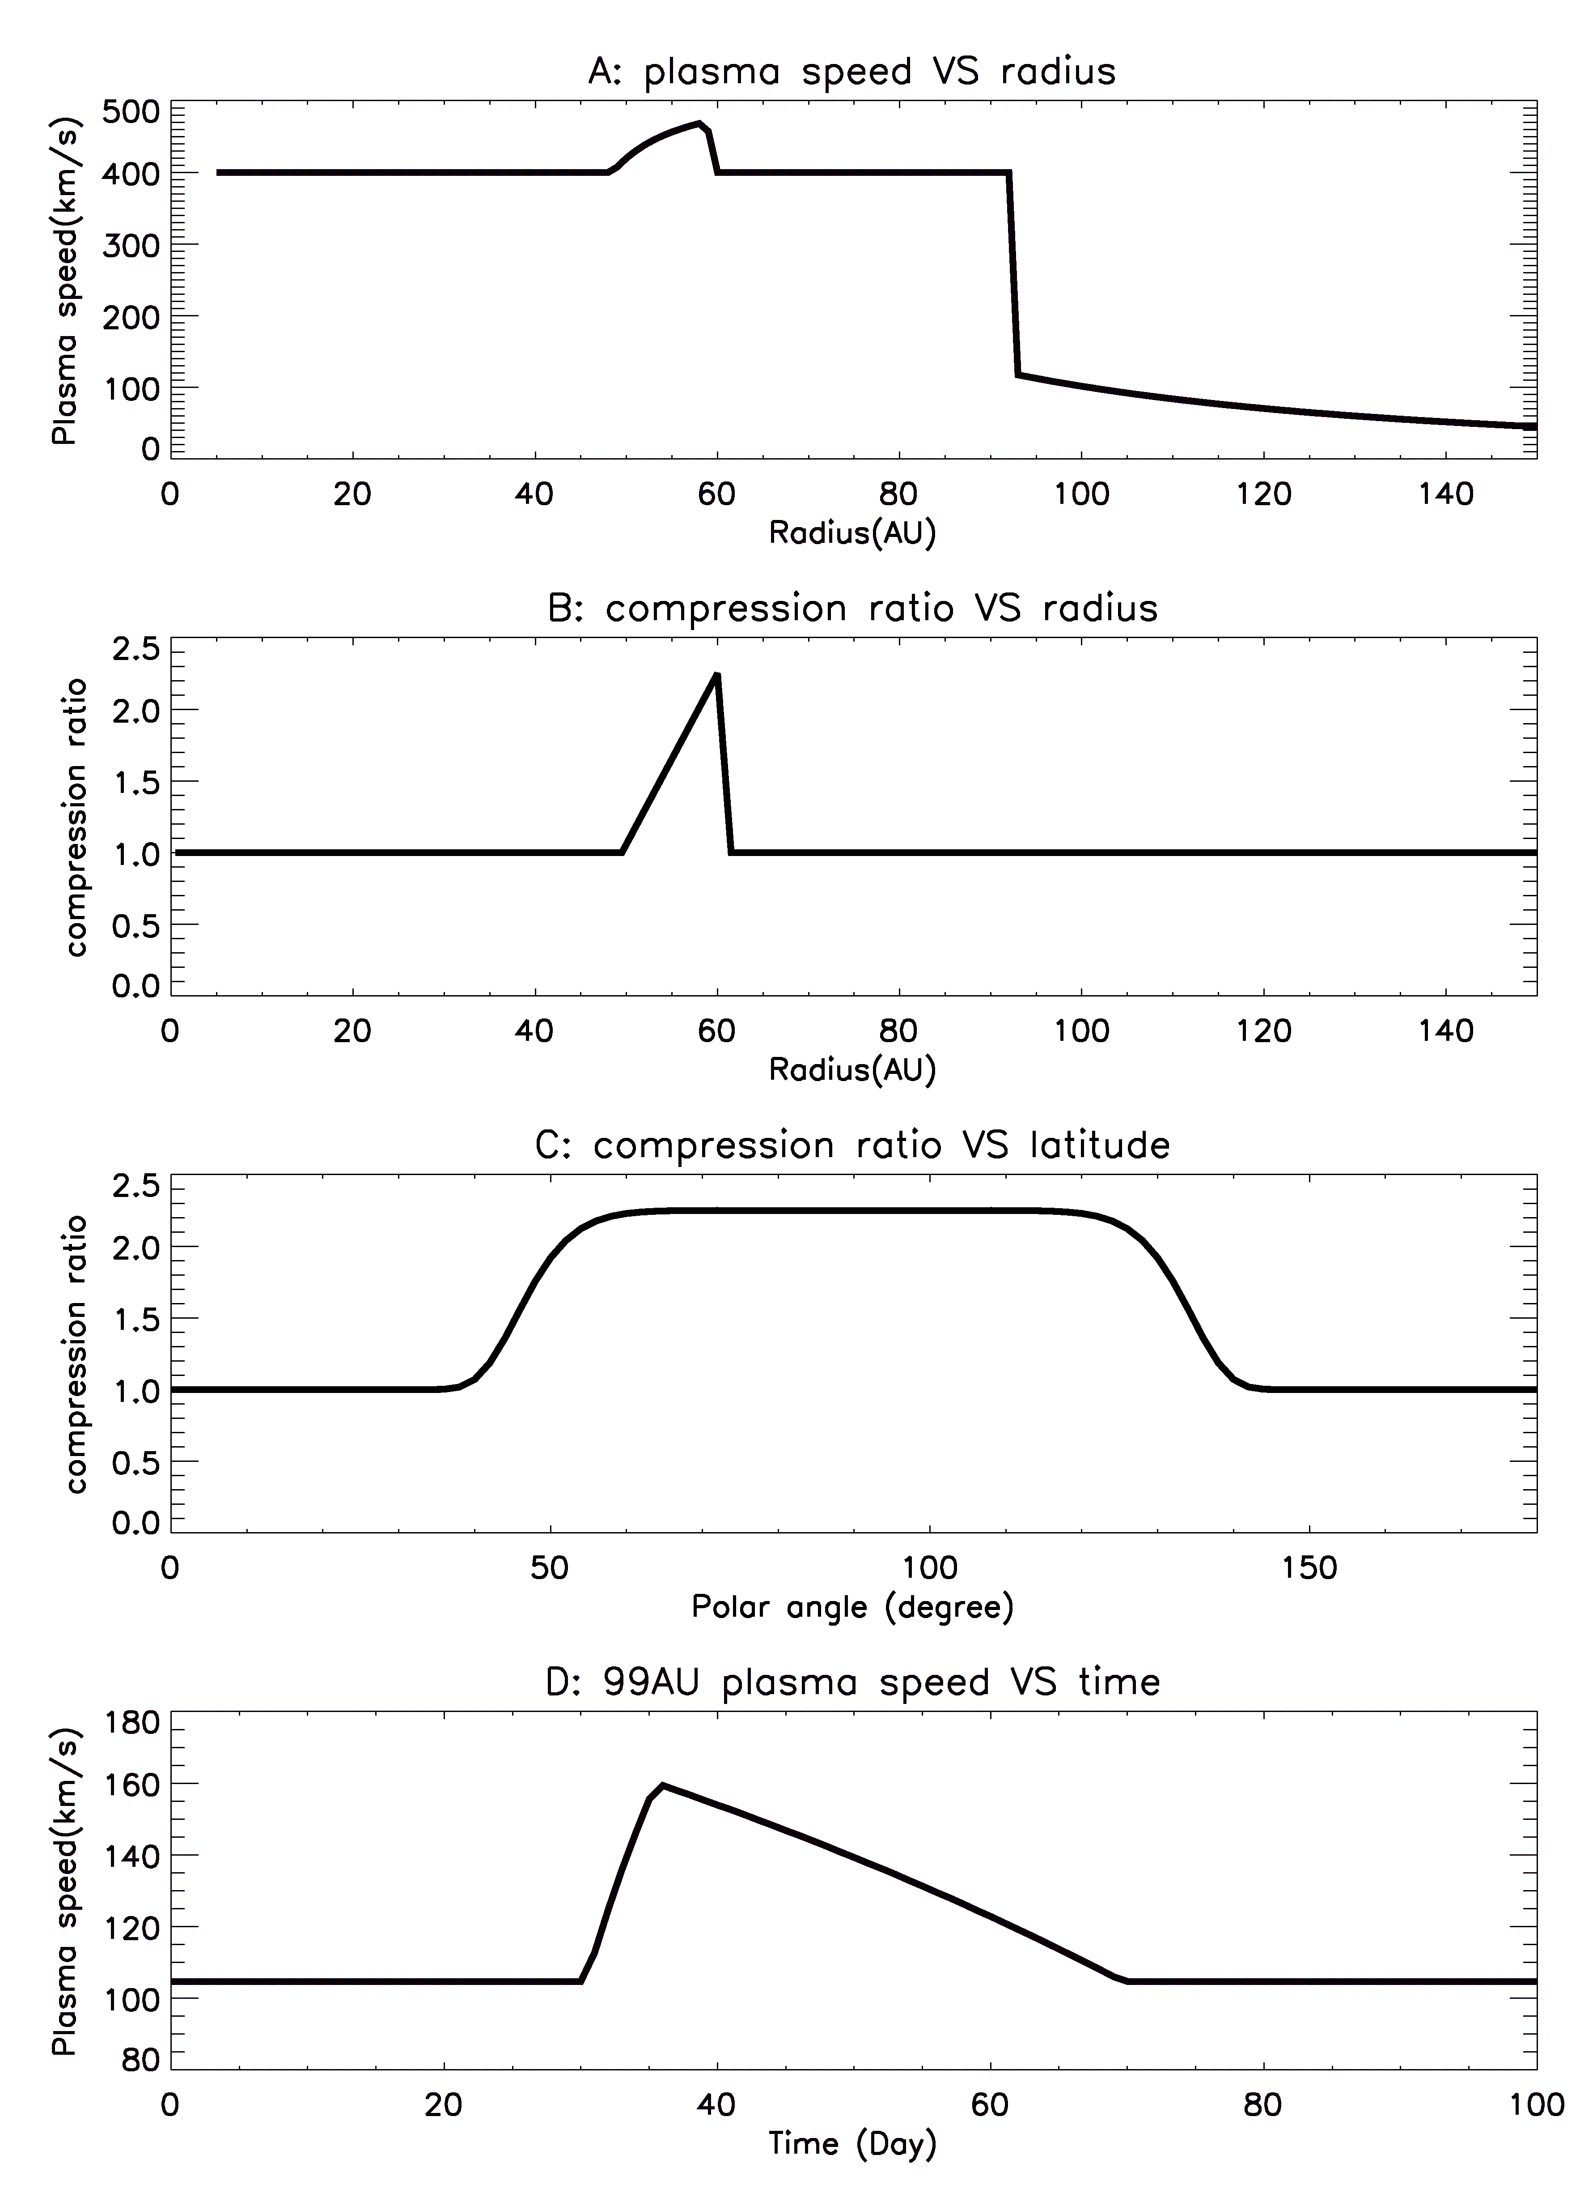
Simulation Model-GMIR
GMIR model used in our simulation.
A) is a snapshot of plasma speed along Voyager 1 direction, as GMIR is located at 60 AU.
B) shows how the shock strength varies with the radius. The GMIR shock has a peak-like shape.
C) shows the profile of how shock strength change with latitude.
D) shows the time profile of plasma speed at 99AU as a GMIR pass by.

Slide 18
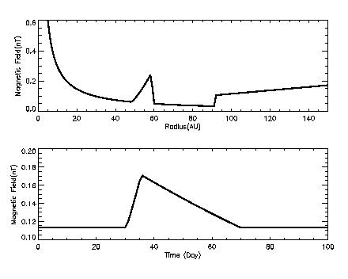
Simulation Model-GMIR (Magnetic Field profile)
The Magnetic field profile. The upper panel roughly along Voyager 1 direction. The lower panel shows the magnetic field change as a GMIR passes by.

Slide 19
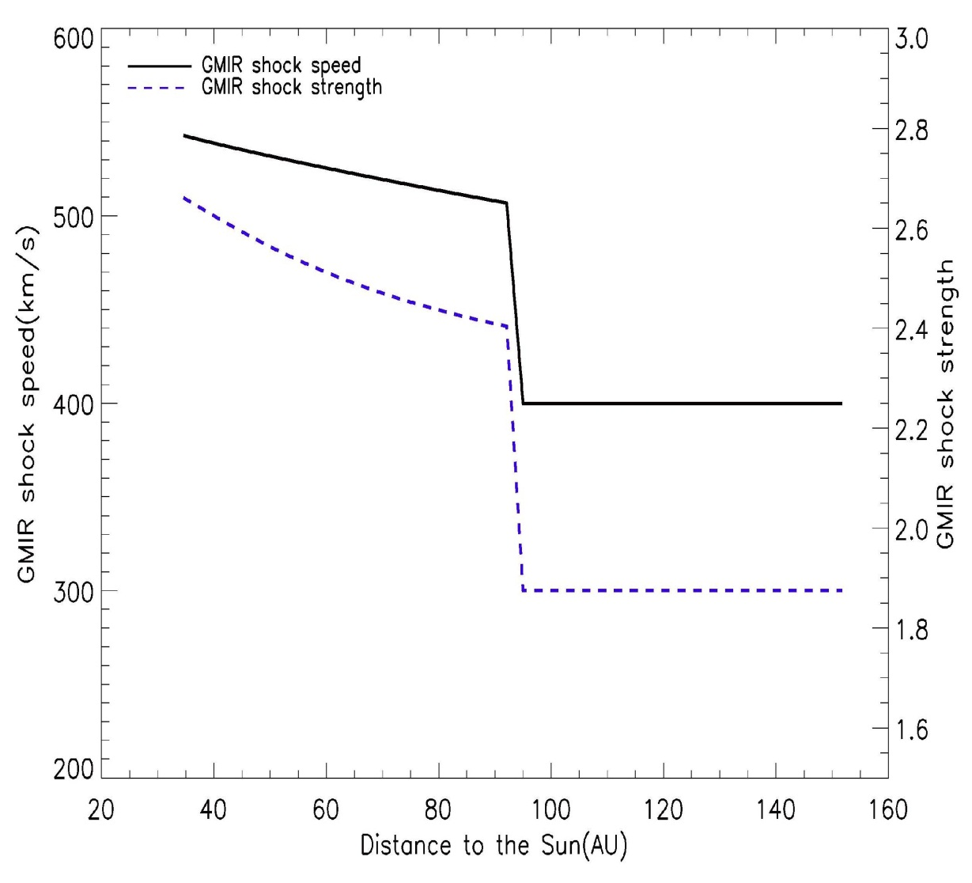
Simulation Model-GMIR
Dynamic Profile
GMIR can propagate inside the heliosphere. We adopt a model proposed by Whang and Lu (1999). The GMIR shock speed and strength both decrease as it propagates. At termination shock, we assume the shock speed and strength experience a sudden decrease. After that, the GMIR shock propagates constantly in the heliosheath.

Slide 20
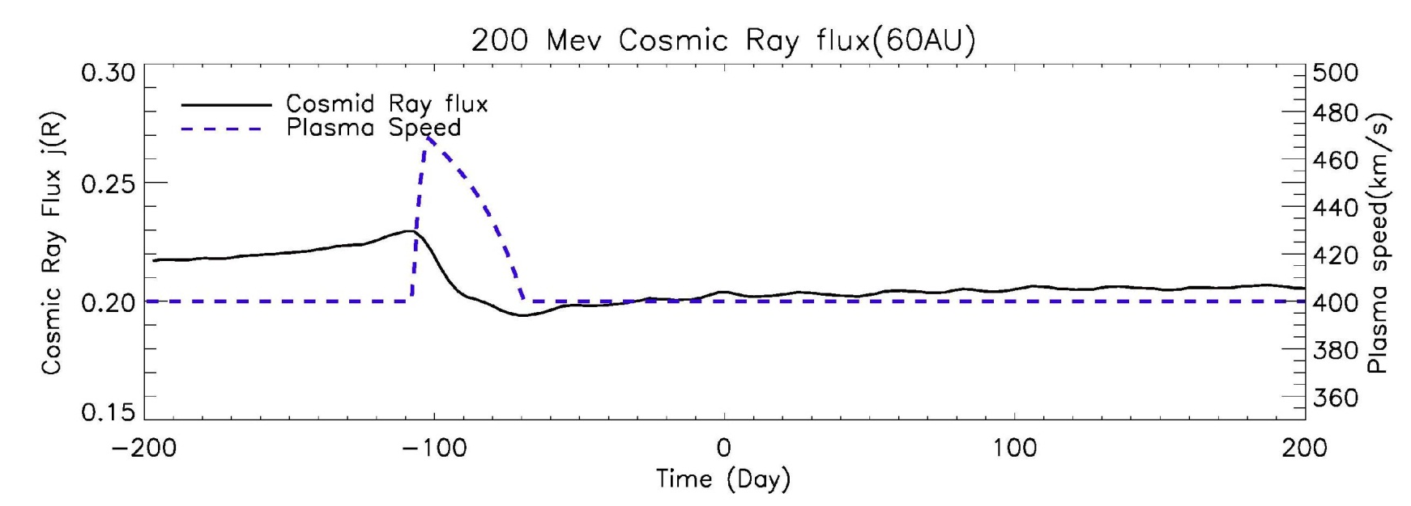
Result of GMIR modulation simulation
Ⅰ In the supersonic solar wind region
Following figure shows that as GMIR passes by, the cosmic ray flux decreases, and the starting point coincides with the GMIR front arrival (plasma speed begin to increase). This scenario agrees with our previous understanding of GMIR effect.
The time profile of cosmic ray flux at 60 AU as GMIR passes by. The plasma speed at that point is also shown in blue curve.

Slide 21
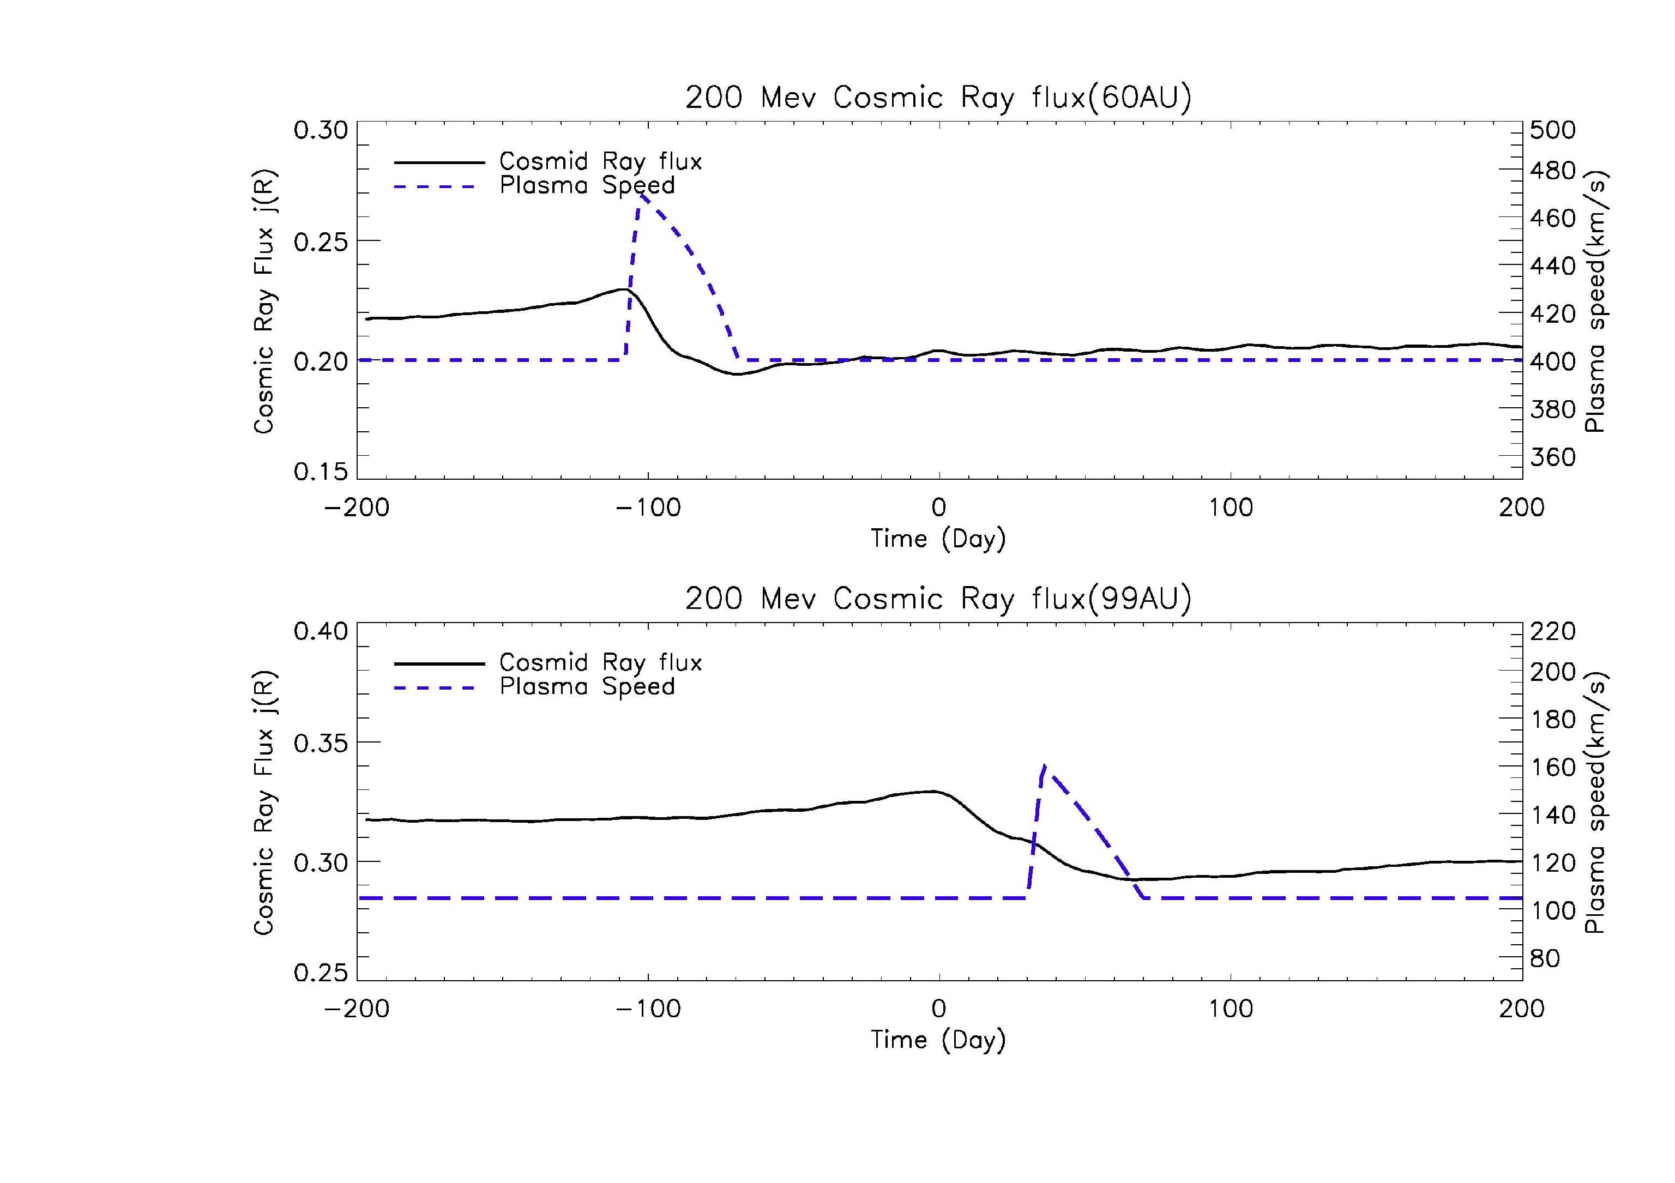
Ⅱ In the heliosheath region
Although the main scenario is similar to the case inside the termination shock, the starting time of cosmic ray flux decrease is ahead of GMIR’s arrival, roughly at t=0, when the GMIR arrives at termination shock.
The time profile of cosmic ray flux at 99 AU as GMIR passes by.

Slide 22
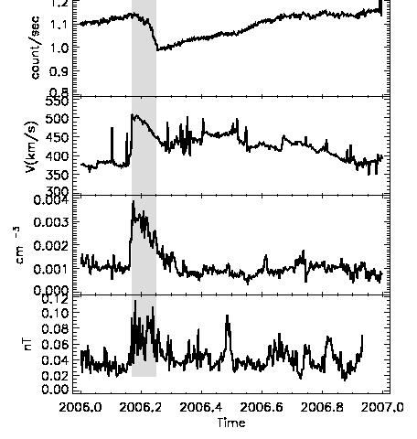
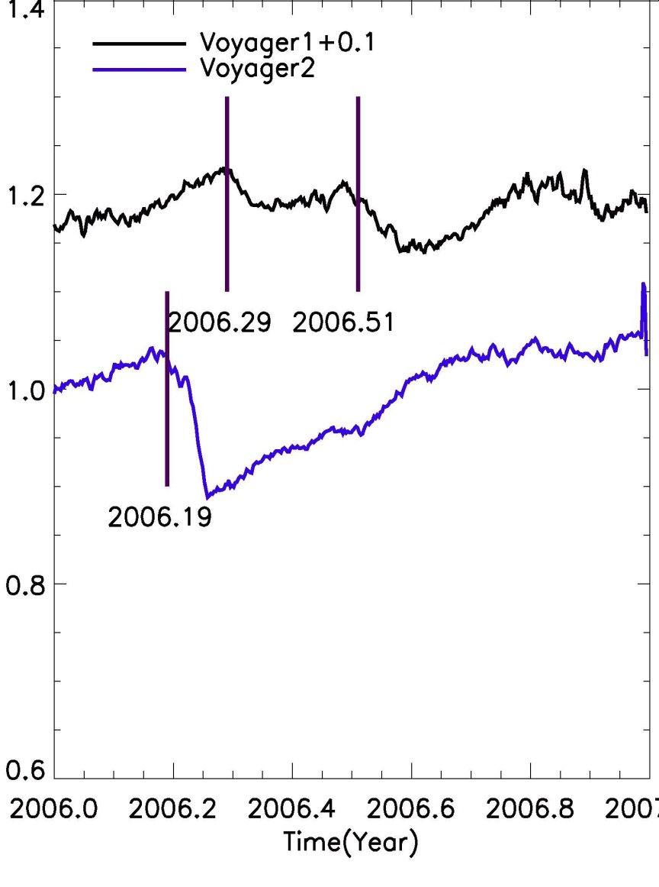
The 2006 GMIR event , cosmic ray intensity, solar wind speed, solar wind density, magnetic field
The Voyagers’ Galactic Cosmic Ray intensity in 2006. The vertical line labels the transient decrease caused by GMIR, and V1’s 2006.29 transient decrease is caused by GMIR’s arrival at Termination Shock.

Slide 23
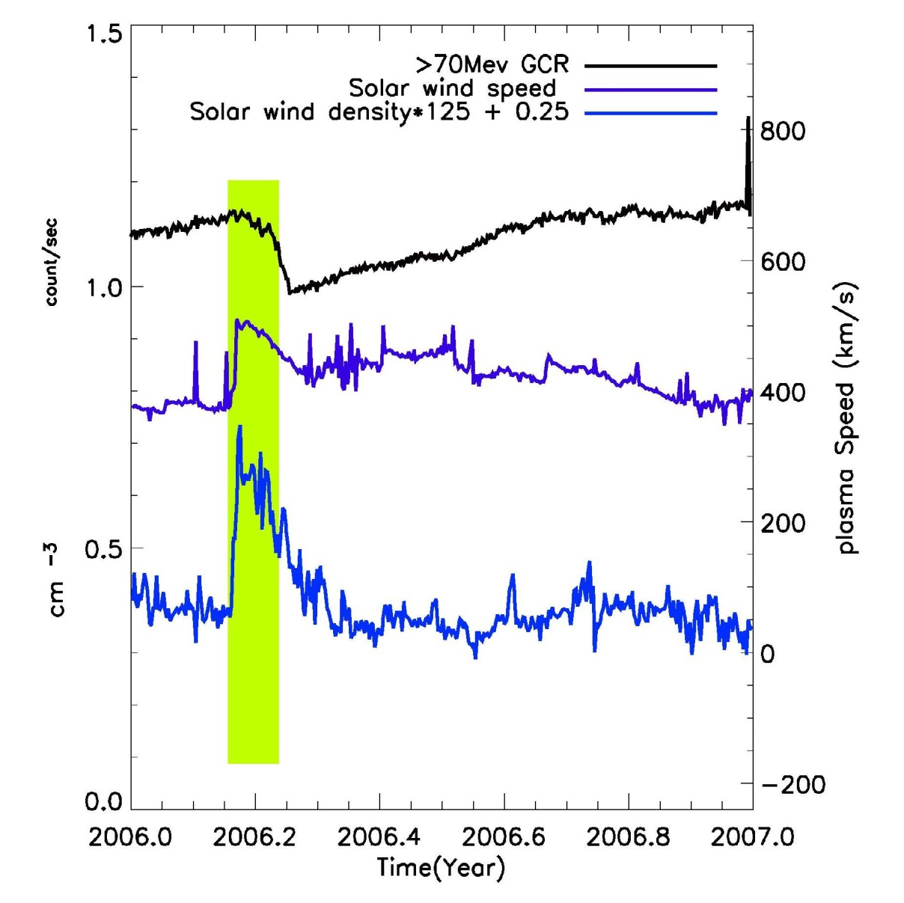
Rankine–Hugoniot relation
Voyager 2’s measurements in 2006

Slide 25
Summary
Solar wind termination shock does affect cosmic ray modulation.
The effectiveness depends on particle diffusion coefficient
No dramatic change of cosmic ray intensity is expected at the termination shock. (10-20%)
The effect of termination shock is mainly seen in cosmic ray radial gradient. The zero radial gradient seen by Voyager perhaps comes from the effect of termination shock.
A non-spherical termination shock can smear the effect of termination as the modulation by the solar wind at different longitudes average out the effect of termination shock.
Termination shock can change the feature of modulation by GMIR. Two FD are expected from GMIR in the heliosheath, one corresponding to GMIR arrival at the termination shock and one occurring at the spacecraft.
Remote sensing of termination shock location with cosmic ray modulation observation. 91 AU at V1 latitude in 2006.

